Slide 1
World Bank’s Revenue Dashboard A Tool for Benchmarking Tax Policy Performance
Fiscal Policy and Sustainable Growth Unit
Macroeconomics, Trade and Investment
Equitable Growth, Finance and Inclusion Vice-Presidency

Slide 2
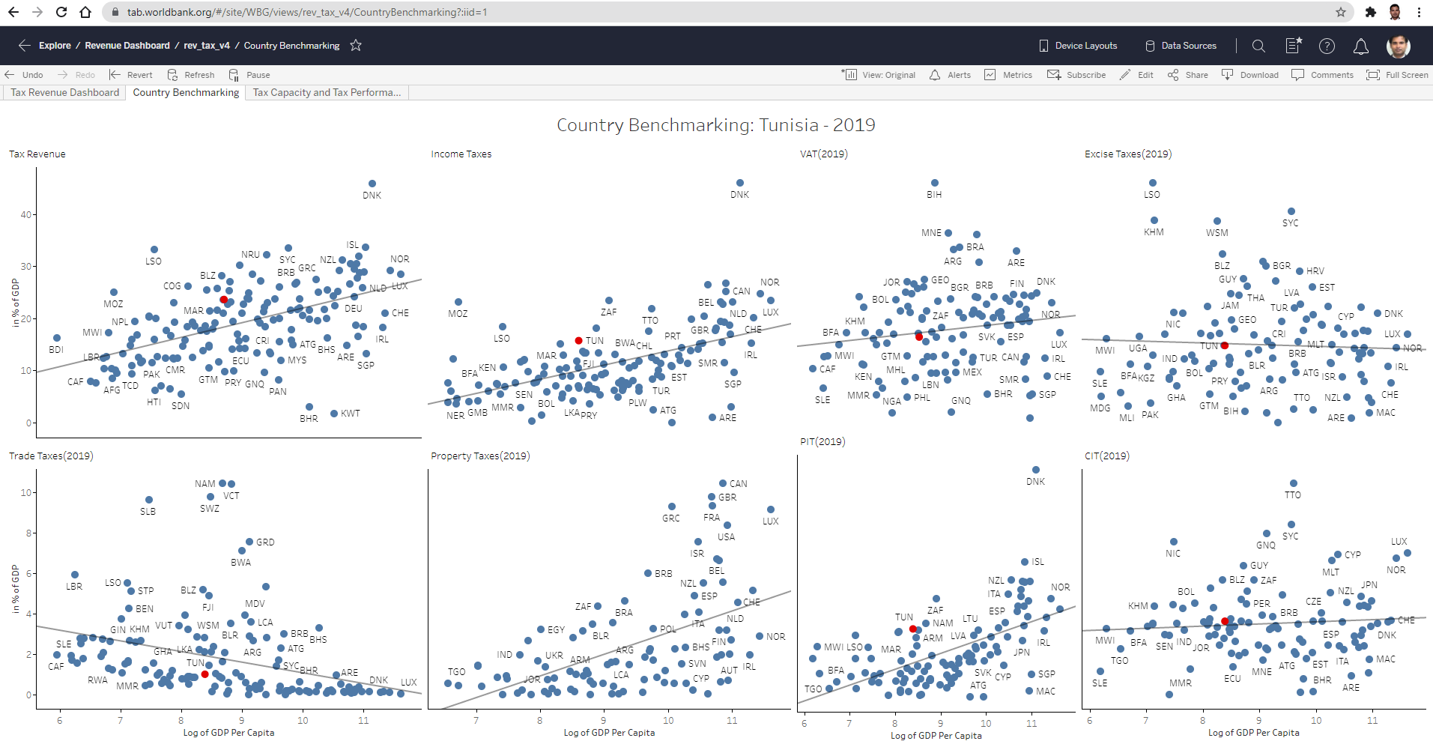
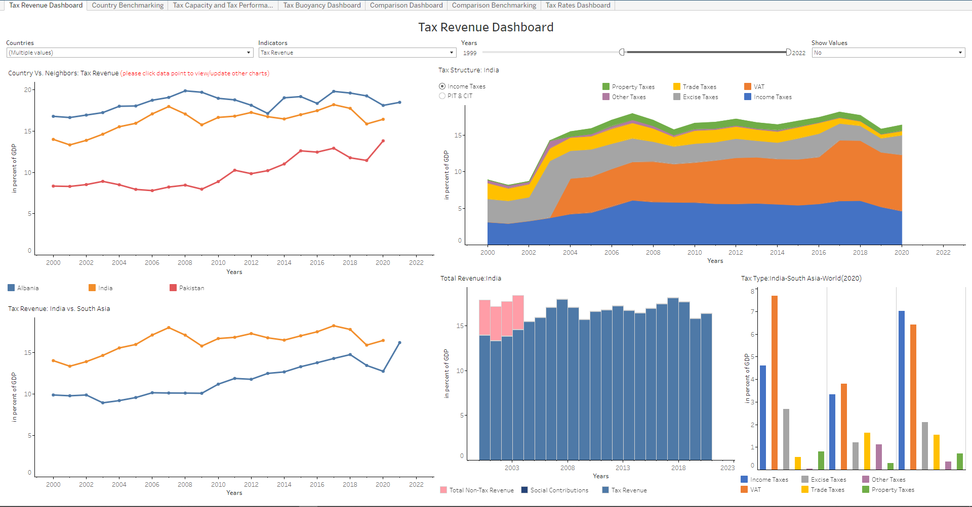
Revenue Dashboard: Overview
A tool to aid World Bank Staff and policy makers and researchers outside with high-level analysis of the performance of a country's tax system
Benchmarks a country’s tax performance with their neighbors and other comparator countries.
Allows analysis of tax trends and tax structure.
Compares a country’s performance with the average and best performer (Tax Capacity/Tax Gap)
Is available on an easily accessible Web-based platform.
Currently uses tax collection data will be expanded to include other relevant data such as C-efficiency, METR & AETR.
The latest year for which data is available is 2020. A HIGH FREQUENCY REVENUE DASHBOARD that provides more recent revenue data from different countries on a monthly/quarterly basis will be piloted soon.
Click here to go to the Dashboard

Slide 3
Tax Revenue Dashboard
The dashboard uses GRD dataset from UNUWider and updated from the different country’s ministry of finance websites.
Tax Rates are sourced from KPMG’s online dataset.
Focuses mainly on interactivity and filters
Single or multiple countries can be selected from “Countries” filter, single indicator can be selected from “Indicators” filter, and time period can be selected using “Years” slider
Clicking on any data point in “Countries vs Neighbors” chart updates the remaining charts
“Tax Type: Country-Region-World” comparison chart is updated based on the selection of the country year.
Click here to go to the Dashboard

Slide 4
Navigating the Dashboard
Use slider to select the years of interest
Use drop-down list to select or type the country name
Use drop-down list to select or type the indicator
Click on country of interest and year. This activates the other charts including those in the other dashboards.
Click on an empty part of the chart to highlight all the country-line charts.

Slide 5
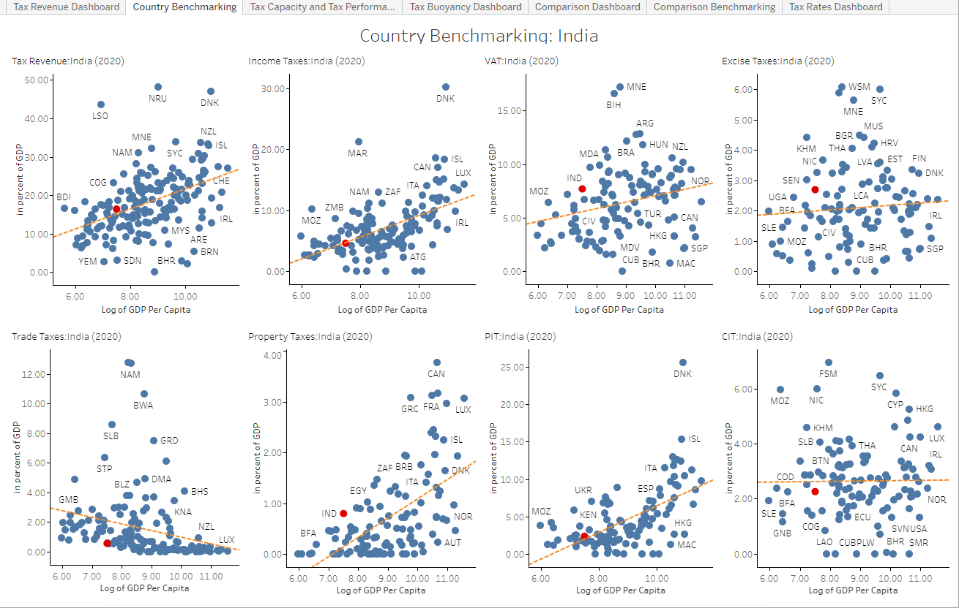
Country Benchmarking
Country Benchmarking Dashboard is updated for each Country and Year combination (can be selected in “Country vs Neighbors” chart from “Tax Revenue” dashboard).
It helps us to understand how the selected country is doing with respect to other countries with similar GDP per Capita or Income Group for Tax Revenue, Income Taxes, VAT, Excise Taxes, Trade Taxes, Property Taxes, PIT, and CIT
Country of interest is indicated in red

Slide 6
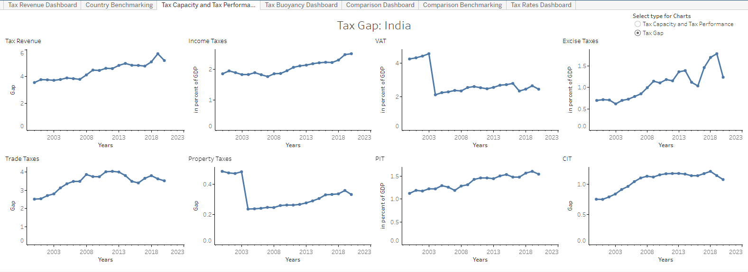
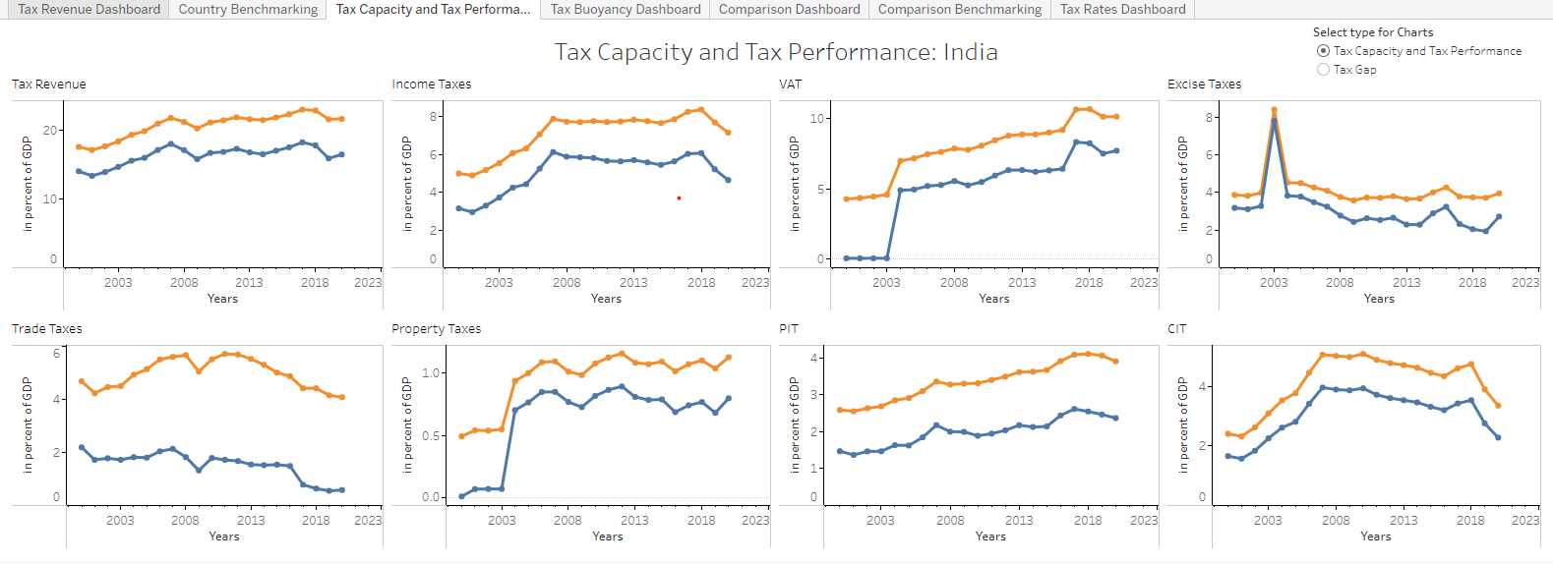
Tax Capacity and Tax Performance
Tax Capacity and Tax Performance Dashboard is updated for each Country (can be selected in “Country vs Neighbors” chart from “Tax Revenue” dashboard).
It helps us to compare the potential of the selected country with the actual values with respect to other countries with similar GDP per Capita or Income Group with respect to Tax Revenue, Income Taxes, VAT, Excise Taxes, Trade Taxes, Property Taxes, PIT, and CIT.
The potential of Country is calculated using Stochastic Frontier Analysis controlling for per capita GDP and the openness.
Choose the Tax Gap or Tax Capacity vs Tax Performance Charts

Slide 7
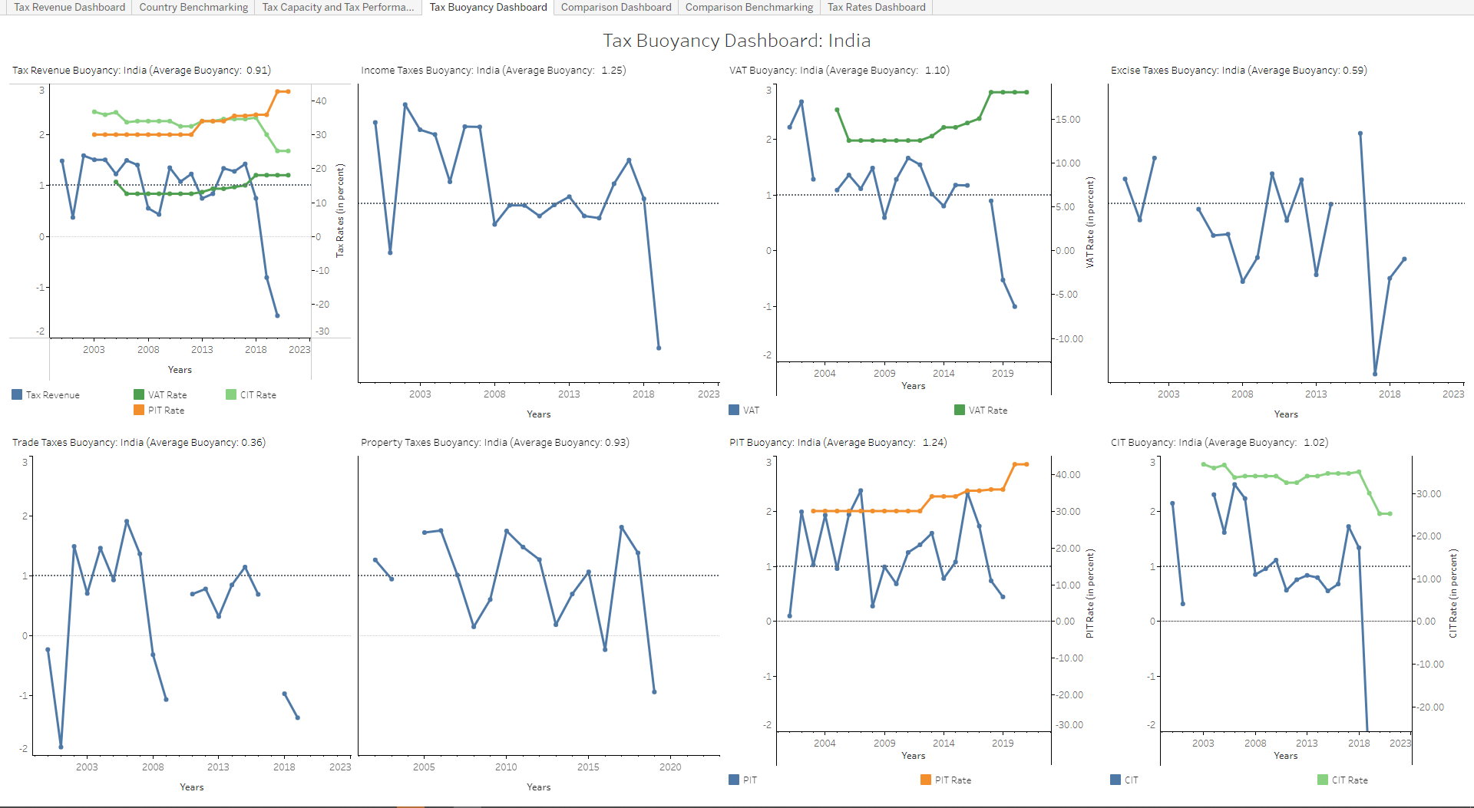
Tax Buoyancy Dashboard
The Tax Buoyancy Dashboard provides the buoyancy for Tax Revenue and the major taxes, PIT, CIT, VAT, Excises and Property Taxes.
The country and years are selected from the Tax Revenue Dashboard.
The charts shows the Buoyancy=1 line for reference and calculates the average buoyancy for the selected years.
The charts also show average PIT, CIT, and VAT Rates to allow users check if the Buoyancy is due to fluctuation in Tax Rates.

Slide 8
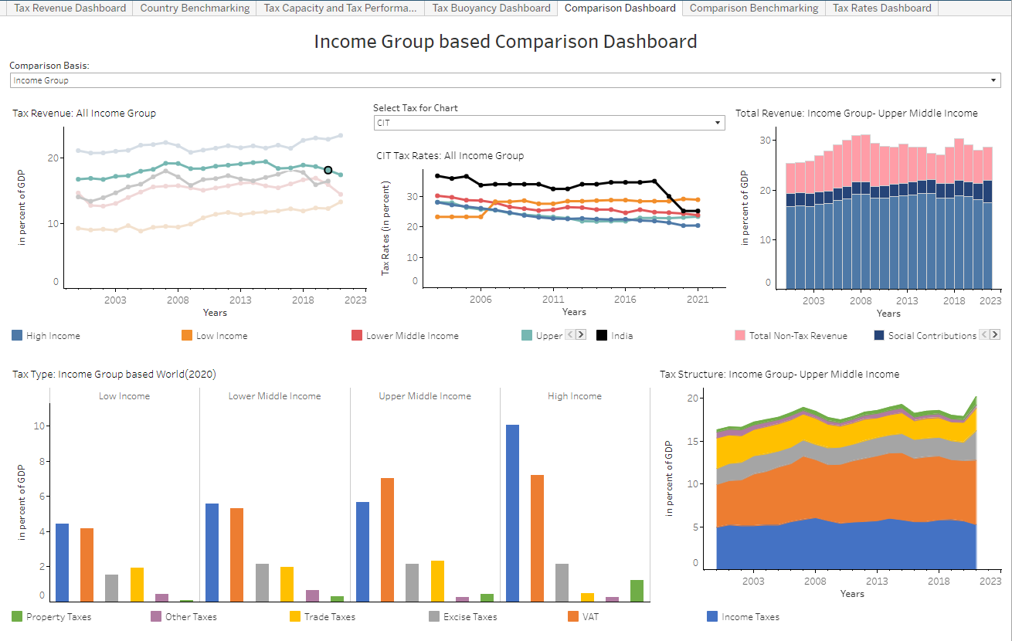
Comparison Dashboard
Single comparator can be selected from “Comparison Basis” filter
Clicking on any data point (“Comparison Basis”, year) in the “Tax Revenue-All <comparator>” chart updates “Tax Rates : All <comparator>”(top middle), “Total Revenue: <comparator>-<selected value>” (top right), and “Tax Structure: <comparator>-<selected value>” (bottom right) charts.
Years are selected from the Tax Revenue Dashboard.
Average Tax Rates for PIT, CIT and VAT for the region are shown in the top-middle chart.
Un-weighted averages are used.
Use drop-down list to select or type the Comparison Basis (like Region, Income Group, etc.)
Click on data point (combination of “Comparison Basis” and “Year”) of interest. This activates the other charts including those in the other dashboards.

Slide 9
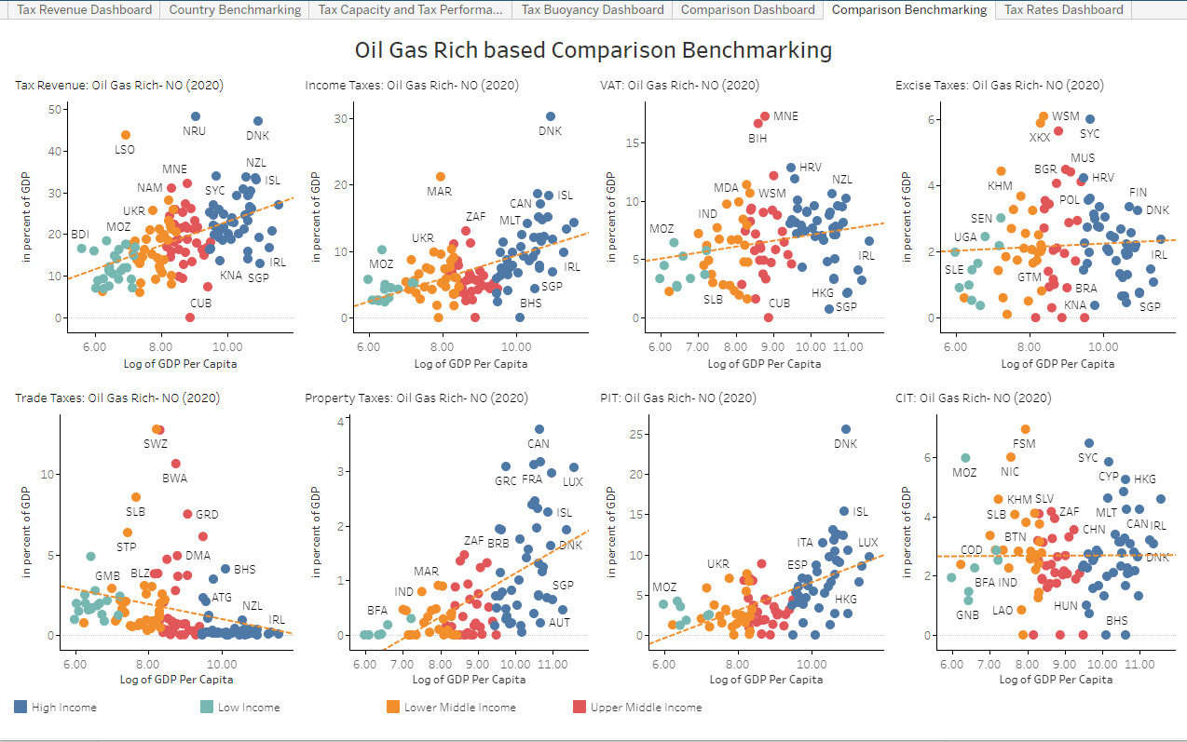
Comparison Benchmarking
Comparison Benchmarking Dashboard shows the countries based on “Comparison Basis” selection and their performance on tax collection. The “Comparison Basis” can be selected in “Tax Revenue-All <comparator>” chart from “Comparison Dashboard”.
It helps us understand and compare the performance of all countries within the selected “Comparison Basis” for Tax Revenue, Income Taxes, VAT, Excise Taxes, Trade Taxes, Property Taxes, PIT, and CIT
By default, the countries are color coded by Income Group except for “Income Group” comparator for which countries are color coded by Region

Slide 10
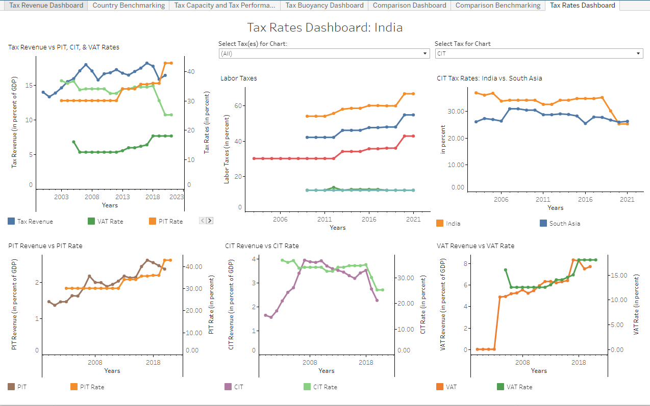
Tax Rates Dashboard
The Tax Rates Dashboard provides the tax rates for the major taxes, PIT, CIT, VAT and Social Security Taxes.
The country is selected from the Tax Revenue Dashboard.
The Tax Revenue vs Rates Chart (top-left) shows the performance of Tax Revenue versus the tax rates for the three major taxes. Individual charts (bottom row) shows the performance of each of these taxes along with the tax rate.
The Labor Taxes chart (top-middle) shows the various taxes/Social Contributions applied on labor.
The Tax Rates vs Region chart shows how the selected countries’ tax rate compares to that of the region.

Slide 11
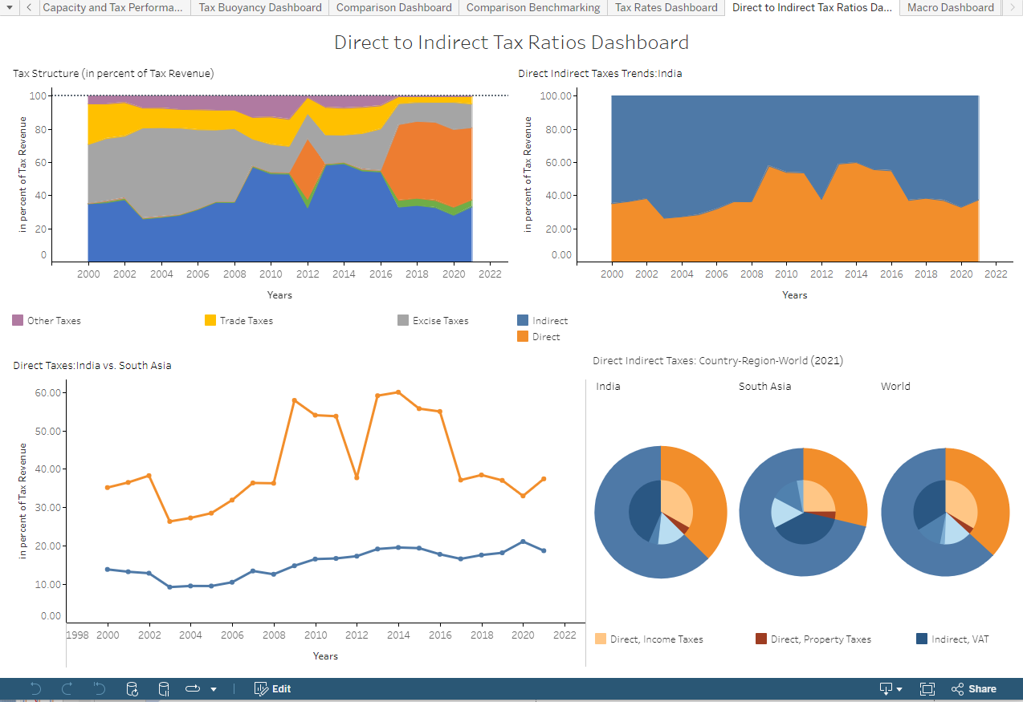
Direct to Indirect Tax Ratios Dashboard
The Direct to Indirect Tax Ratios Dashboard focuses on Direct to Indirect Tax Ratios which is one of the key parameter to measure Progressivity.
The country is selected from the Tax Revenue Dashboard.
The Tax Structure (in percent of Tax Revenue) (top-left) focuses on second level taxes (like Property, Income, VAT, Excise taxes) are contributing towards the total Tax Revenue.
Direct Indirect Taxes Trends (top right) chart conveys the distribution of total Direct and Indirect Taxes.
The Direct Taxes (bottom left) compares Direct Taxes for the selected country and its region.
The Direct Indirect Taxes: Country-Region-World (bottom right) compares Direct Indirect Taxes and the second level taxes for selected country, its region, and world.
Income and Property Taxes are considered as Direct Taxes and whereas VAT, Excise, Trade, and Other Taxes are considered as Indirect Taxes.

Slide 12
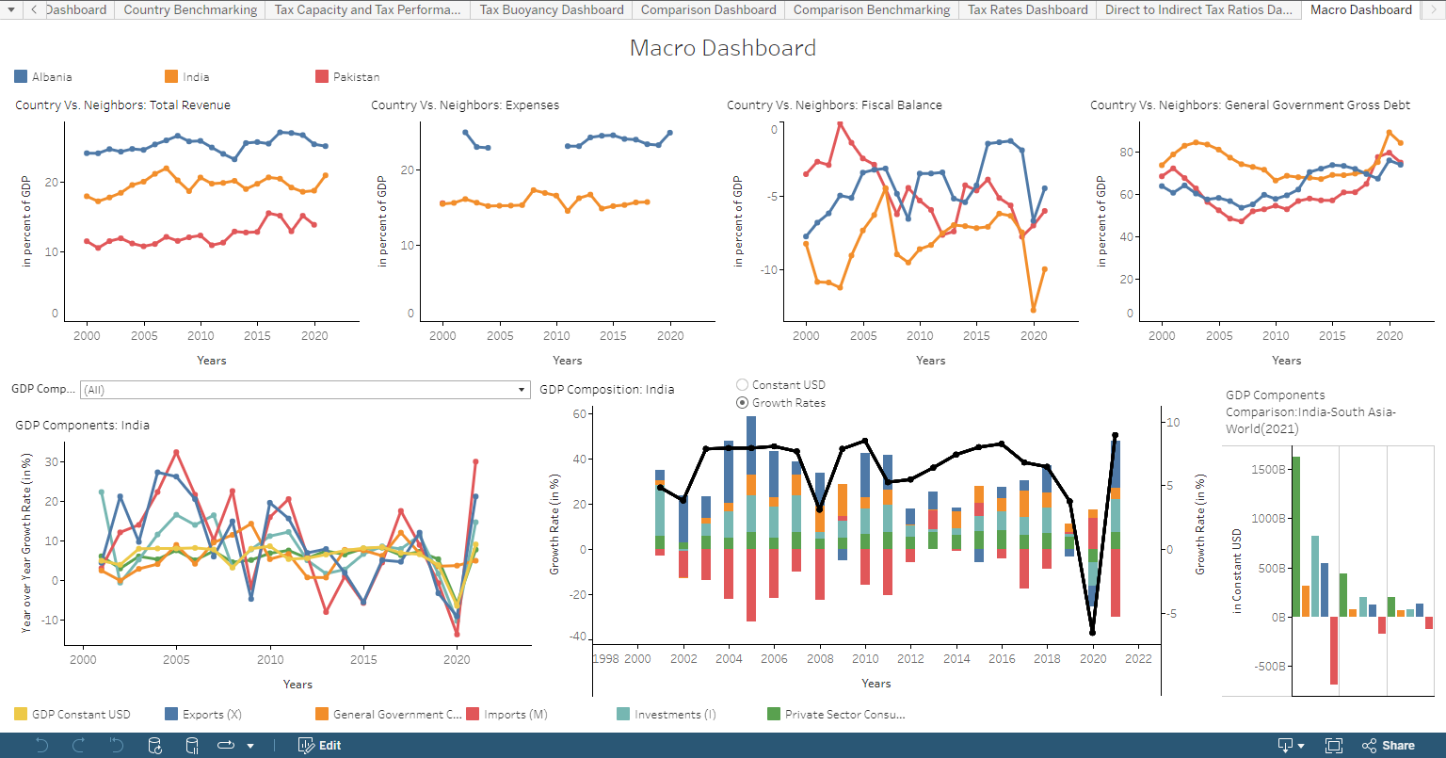
Macro Dashboard
The Macro Dashboard focuses on various GDP components in addition to Total Revenue, Expenses, Fiscal Balance, and General Government Gross Debt.
The countries are selected from “Country vs. Neighbors” chart from the Tax Revenue Dashboard.
Country vs Neighbors: Total Revenue, Country vs Neighbors: Expenses, Country vs Neighbors: Fiscal Balance, and Country vs Neighbors: General Government Gross Debt (top row) charts focuses on comparing the referred indicators for selected countries.
GDP components chart (bottom left) focuses on GDP (constant USD) along with the components. User can select multiple or all components for comparison.
GDP Composition chart (bottom middle) allows user to view GDP composition with all the components either in Constant USD or in Growth Rates percentage.
GDP Components Comparison (bottom right) chart focuses on comparison of GDP components among selected country, its region, and world.
Choose Constant USD or Growth Rates option

Slide 13
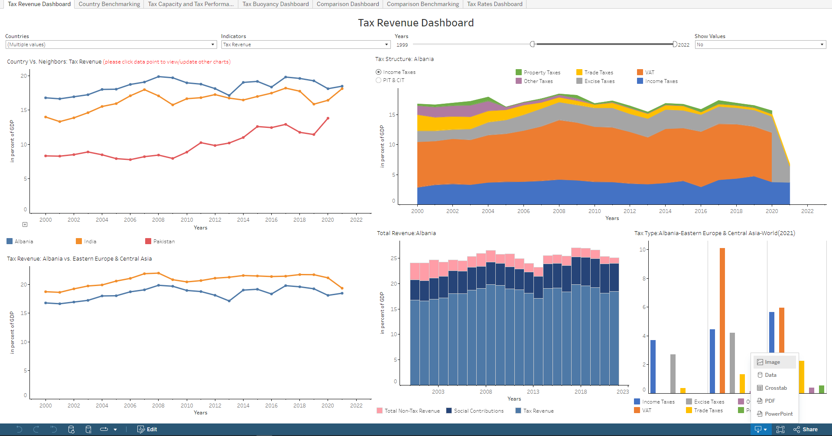
Downloading Data and Charts
Selecting Download activates various options to download Data (csv/Excel) and Charts. Selecting PDF/PowerPoint allows selection of individual charts

Slide 14
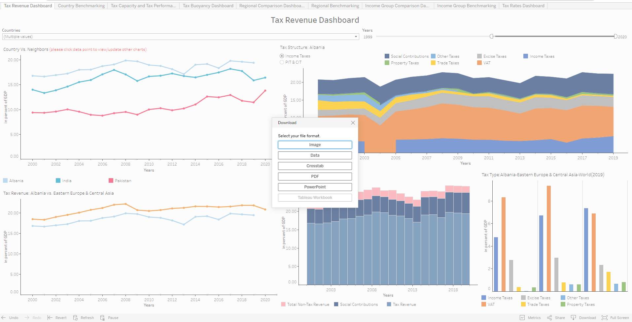
Downloading Data and Charts
Selecting Download activates various options to download Data (csv/Excel) and Charts. Selecting PDF/PowerPoint allows selection of individual charts

Slide 15
Something more…
A HIGH FREQUENCY REVENUE DASHBOARD that provides more recent revenue data from different countries on a monthly/quarterly basis will be piloted soon.
Users can subscribe to these dashboards to receive periodical updates.
Users can also define alerts based on data conditions to receive critical updates.
Data updating will be carried on periodically.

Slide 16
Thank you
Contacts:
Sebastian James, sjames2@worldbank.org
Nikhil Brahmankar, nbrahmankar@worldbank.org

